Slide 1
Introduction to Spark
Priti Bhardwaj, CDAC Noida, India

Slide 2
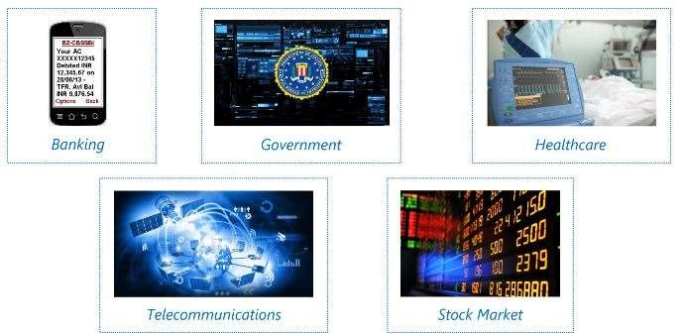
Real Time Analytics

Slide 3
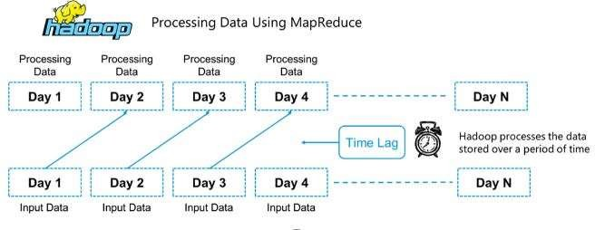
Why Spark when Hadoop is already there?

Slide 4
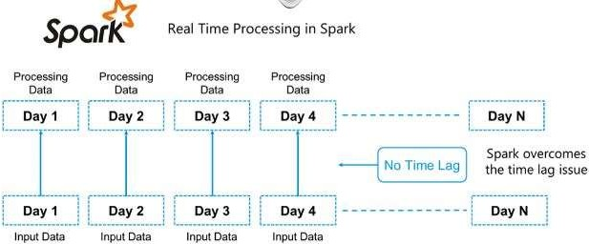
Why Spark when Hadoop is already there?

Slide 5
What is Spark?
Apache Spark is an open source cluster computing framework for real-time data processing.
Main feature of Apache Spark : in-memory cluster computing that increases the processing speed of an application.
Spark provides an interface for programming entire clusters with implicit data parallelism and fault tolerance.

Slide 6
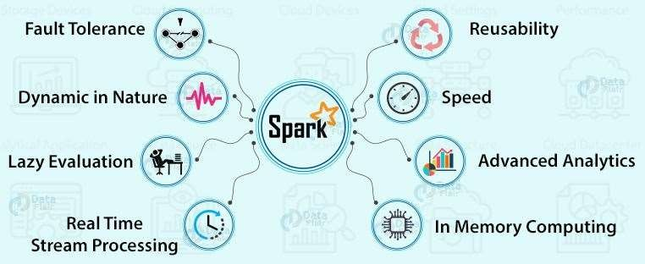
Features of Apache Spark

Slide 7
Spark Components
Spark
SQL
Spark Streami ng
Spark
MLlib
GraphX
SparkR
Apache Spark Core API

Slide 8
Resilient Distributed Dataset(RDD)
RDDs are the building blocks of any Spark application. RDDs Stands for:
Resilient: Fault tolerant and is capable of rebuilding data on failure
Distributed: Distributed data among the multiple nodes in a cluster
Dataset: Collection of partitioned data with values

Slide 9
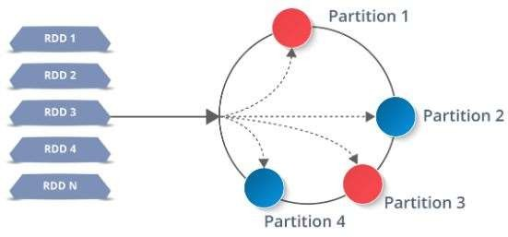
Resilient Distributed Dataset(RDD)

Slide 10
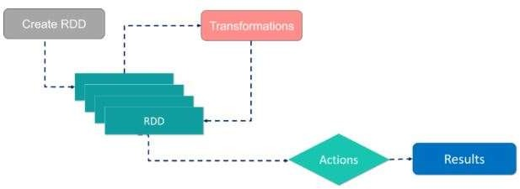
Resilient Distributed Dataset(RDD)

Slide 11
Resilient Distributed Dataset(RDD)
Two types of operations:
Transformations: They are the operations that are applied to create a new RDD.
Actions: They are applied on an RDD to instruct Apache Spark to apply computation and pass the result back to the driver.

Slide 12
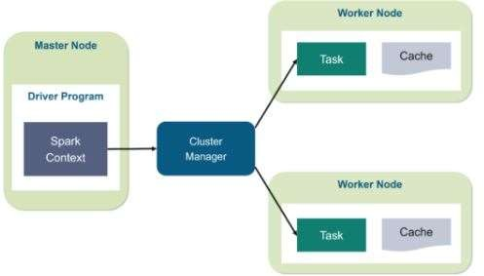
Working of Spark Architecture

Slide 13
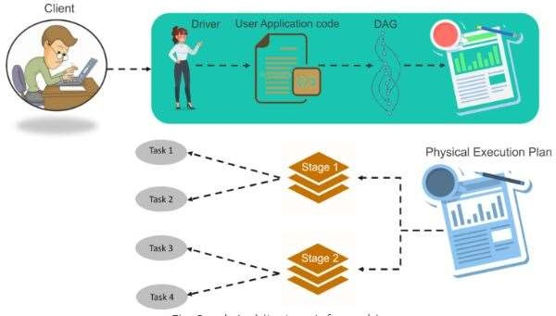
Working of Spark Architecture

Slide 14
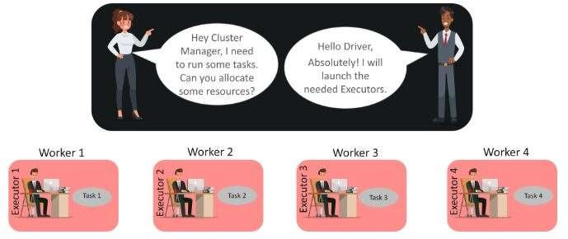
Working of Spark Architecture

Slide 15
Thank You

